Slide 1
Leveraging Technology for Seamless Peer Services
KRISTINA VACCARO CCAR COACH, CCAR TRAINER, WI CPS TANYA KRAEGE APSW, CSAC, MSW, CCAR COACH, CCAR TRAINER, WI CPS TRAINER
Notes:
Introduce yourselves.

Slide 2
Disclosures
Notes:
Kristina and Tanya work at Safe Communities MDC where peer services are provided. Kristina and Tanya are co-founders of Ventus Rex, where Rex, the peer provider software is housed and have shares in the company.

Slide 3
OVERVIEW
Peer program data challenges
Utilizing data-based approaches to peer work
Evidence based practices & Obtaining more funding
Notes:
Tanya

Slide 4
ROLE OF THE PEER PROVIDER
Meets people where they are.
Hold safe space for people to share their experiences
Advocate for needs to be met and be treated with dignity and respect.
Encourage a comprehensive wellness model by connecting all providers and agencies with those seeking services.
Brokering for resources: Housing, food, substance use and mental health treatment, community-specific treatment, employment, education, and transportation needs
To be that person who understands, is patient, and is free of judgment.
Notes:
Kristina
As many of you here are probably aware what peer support is, we want to give a brief overview for those who may not be as familiar, and is in no way all encompassing of what the peer role may look like. It could include peer mentors, recovery coaches, peer support specialists, etc. Peer provider or provider, from henceforth in this presentation, is referring to people working with individuals experiencing mental health, substance use challenges, or adverse life experiences in a variety of different settings. (Go over bullet points)

Slide 5
How did we get here?
Notes:
Kristina
Background on the work we do at Safe (in general terms)
Searching for solutions, but none quite fit the unique needs of peer providing organizations and the data points we wanted to collect.

Slide 6
DATA PROBLEMS AS YOU SCALE
1. PARTICIPANT DATA
2. PROVIDER DATA
3. SUCCESS DATA
4. REPORTING
5. BILLING/ FUNDING
6. USE DATA TO IMPROVE SERVICES
Notes:
Tanya
Challenges we see in our own organization and others we have worked with can really be placed into these categories
Spreadsheets, paper based, manual entry, administrative burden, data loss and error, time tracking and reporting

Slide 7
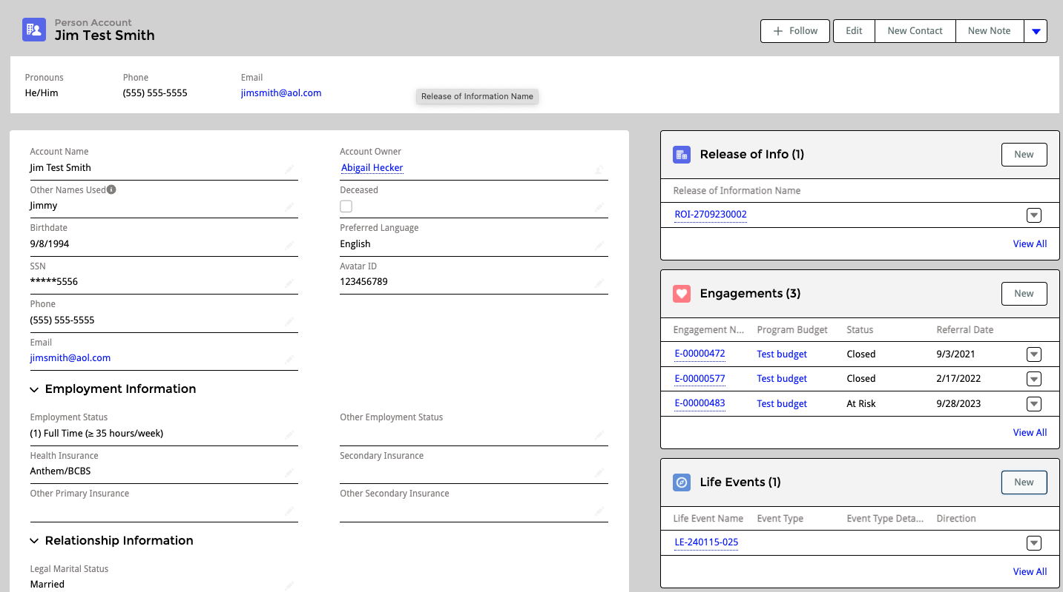
PARTICIPANT DATA
History
Substance use and challenges
Mental health
Notes:
Kristina
In order to provide effective peer services, we need to understand all of the data associated with the participant. This includes their history, which can go back many years, the recovery status, interests, and all of the information associated with them coming back into services again in their referral or intake. We also wanna make sure that we don't have participants duplicated in the system, or that is is overly cumbersome to find information about participants. This is not only important for administrators, but also extremely important to providers who may be faced with situations where they need to quickly reference, historical data and information to provide the most effective peer engagement

Slide 8
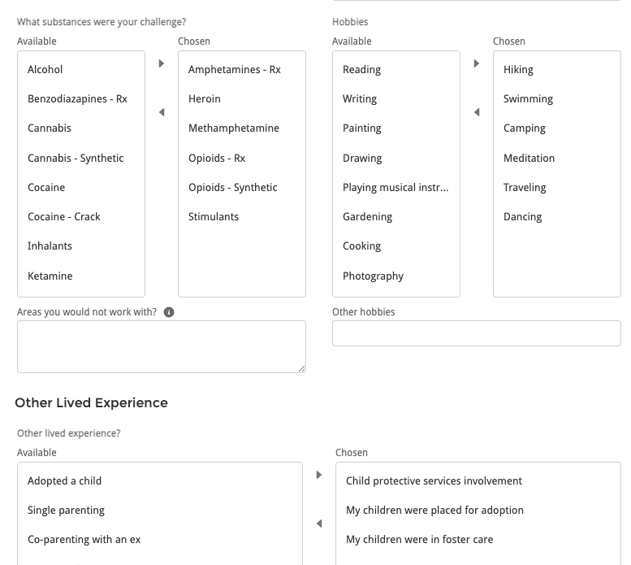
PARTICIPANT x PROVIDER DATA
Referral form and provider matching
Match to Provider (recovery, interests, etc)
Intake/Referral info
Notes:
Tanya

Slide 9
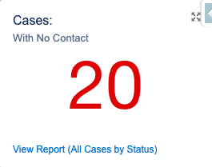
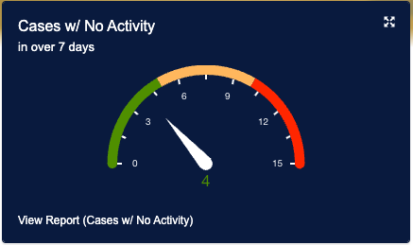
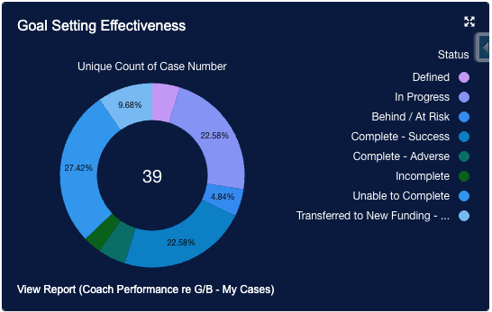
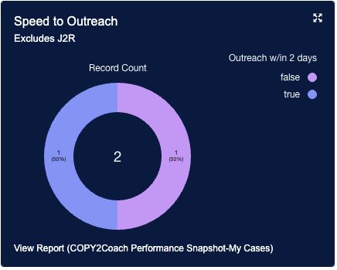
PARTICIPANT DATA
Ensure participants engagement
Setting Goals
Quick outreach
Avoid having participants fall through cracks
See who is at risk and get them extra support
Notes:
Kristina
In order to provide effective peer services, we need to understand all of the data associated with the participant. This includes their history, which can go back many years, the recovery status, interests, and all of the information associated with them coming back into services again in their referral or intake. We also wanna make sure that we don't have participants duplicated in the system, or that is is overly cumbersome to find information about participants. This is not only important for administrators, but also extremely important to providers who may be faced with situations where they need to quickly reference, historical data and information to provide the most effective peer engagement

Slide 10
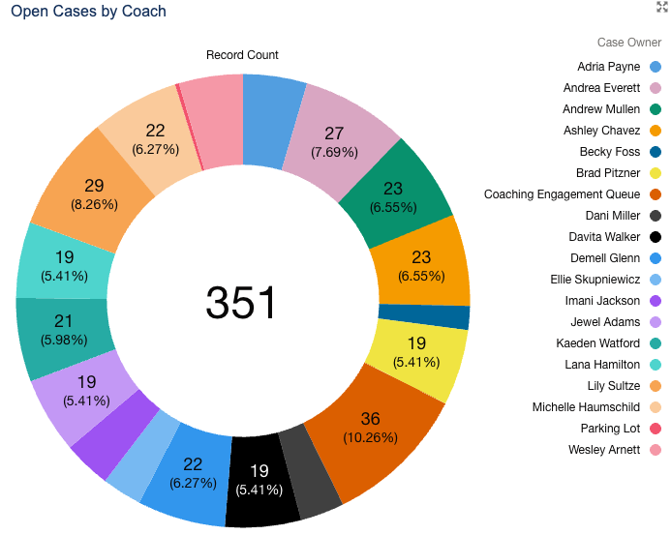
PROVIDER DATA
Open Engagements by Provider
Caseloads/ Engagements
Who is at capacity
Where do we assign new engagements?
How do we support our team?
Notes:
Tanya
Keeping track of providers is also critical as you scale your programs. You want to be able to see all of the history of a provider. See their caseloads and understand who may be at capacity. This helps you assign new engagements when they come in. You also want to be able to track your CU and support your peers from the perspective of keeping their CEU up-to-date. Wanna also be able to have flags so that when PEER is run into situations where they need extra support from you as an organization, you know where to find that information.

Slide 11
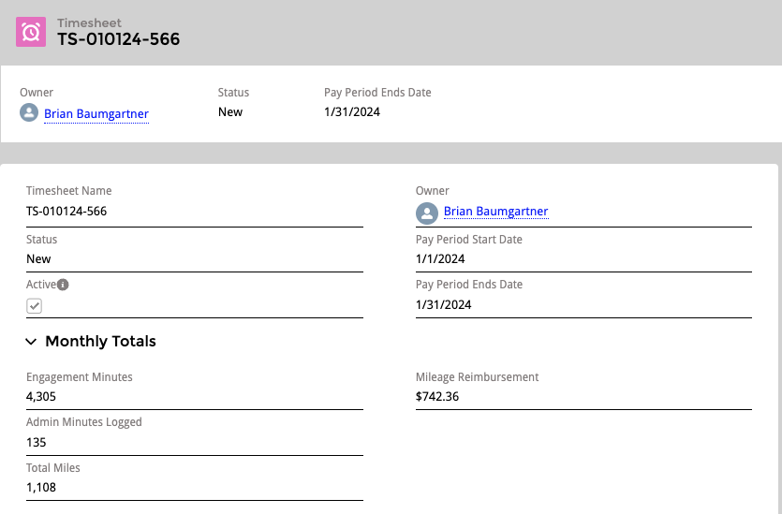
PROVIDER DATA
Track CEUS
Track Hours and Mileage/Reimbursement
Support providers in real time.
Notes:
Kristina

Slide 12
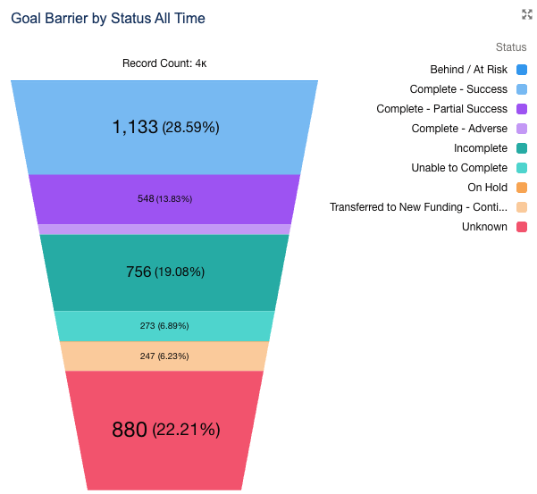
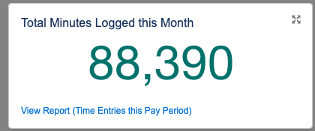
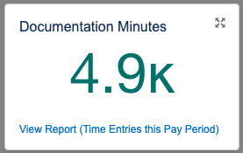
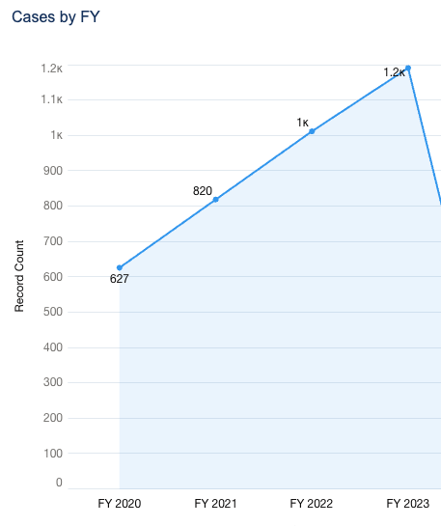
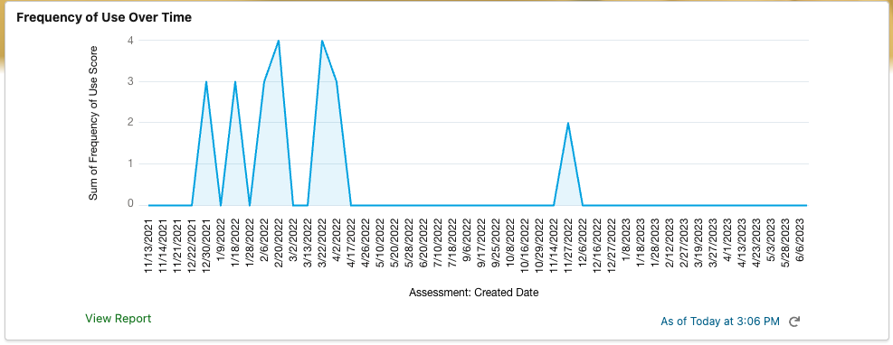
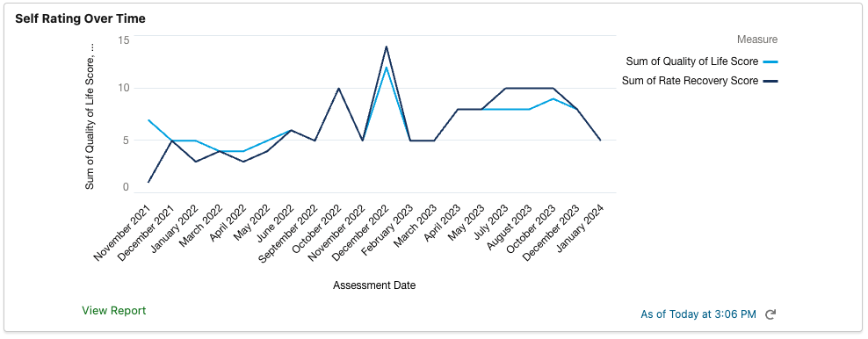
SUCCESS DATA
How to measure success?
Qualitative Data
Quantitative Data
Align with Research
Improve quality of life
Improve engagement with services and supports
Improve whole health and chronic conditions
Decrease hospitalizations
Mental health
Notes:
Tanya

Slide 13
SUCCESS DATA
How to Quantify success metrics?
Substance use
Goals Achieved
Employment & Education
Legal/Criminal Justice
Basic Needs
Quality of Life
Mental Health
Notes:
Kristina

Slide 14
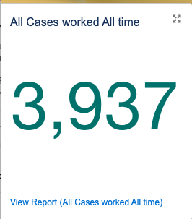
SUCCESS DATA
Program Quantitative Data
Total service minutes
Documentation and admin time
Total cases/engagements vs last year
Notes:
Tanya

Slide 15
SUCCESS DATA
Client-Driven Goals
Achieved / In Progress
Slice data in more ways
Notes:
Kristina

Slide 16
SUCCESS DATA
Substance Use Information
Readiness Check in
At individual level
Aggregated
Notes:
Tanya

Slide 17
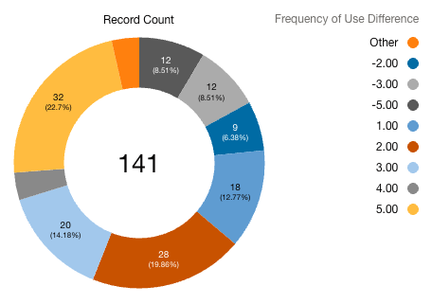
SUCCESS DATA
Substance Use Information
Roll up for closed engagements
Notes:
Kristina

Slide 18
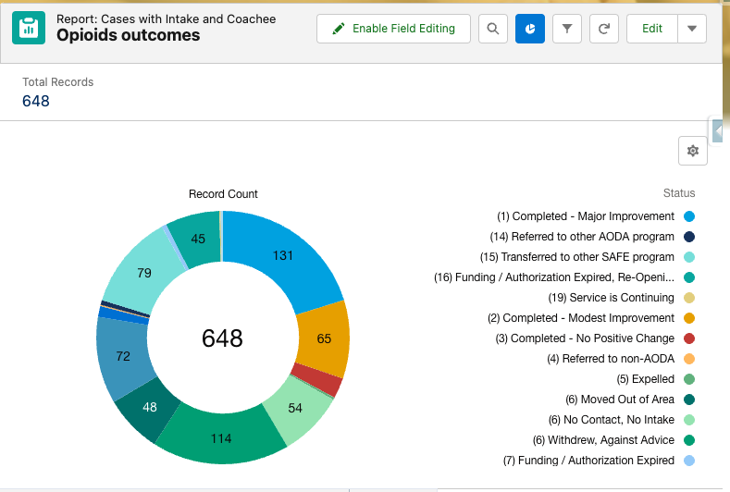
SUCCESS DATA
Opioid Outcomes
Notes:
Tanya

Slide 19
SUCCESS DATA
Self-Rating
Participants self rating for quality of life and recovery.
Notes:
Kristina

Slide 20
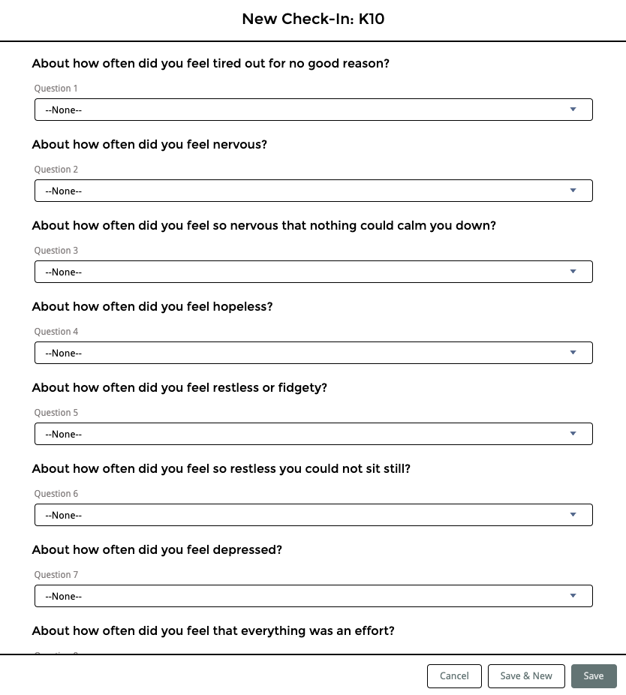
SUCCESS DATA
Mental Health Approaches
K10 Check In
Other approaches
Notes:
Tanya
K10 is a tool that can be used to measure mental health self ratings over time and how it has improved over time. There are, of course, other tools that can be used to monitor changes over time. Depending on the data that each individual organization collects will determine which data is entered into Rex.

Slide 21
TRACKING NALOXONE DISTRIBUTION
Notes:
Kristina

Slide 22
DATA TO IMPROVE SERVICES
Using data with participants
Participant driven
Visualize progress over time
Notes:
Tanya

Slide 23
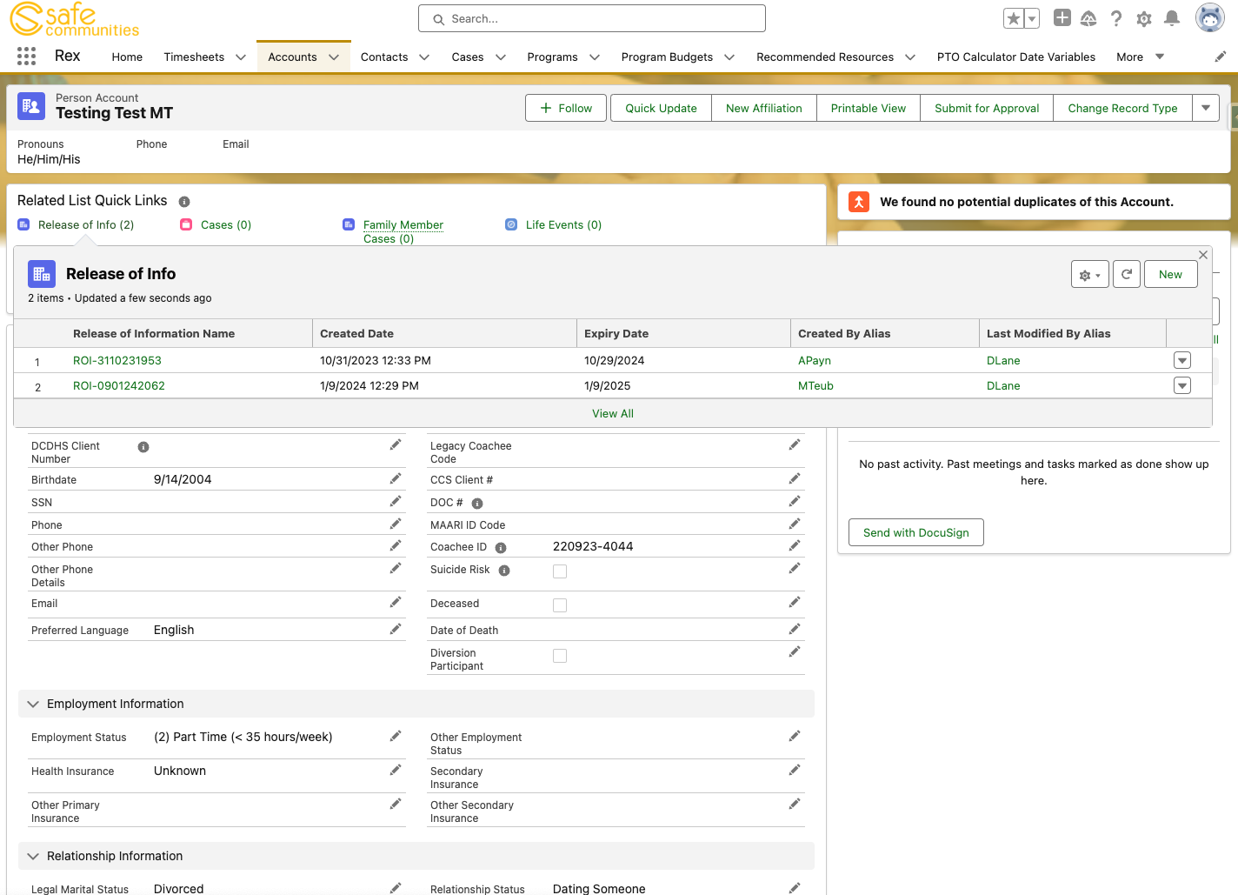
DATA TO IMPROVE SERVICES
Continuity of services as providers change
All data is stored with the participant - ROI, etc.
Simple to pick-up when someone else is out
Notes:
Kristina

Slide 24
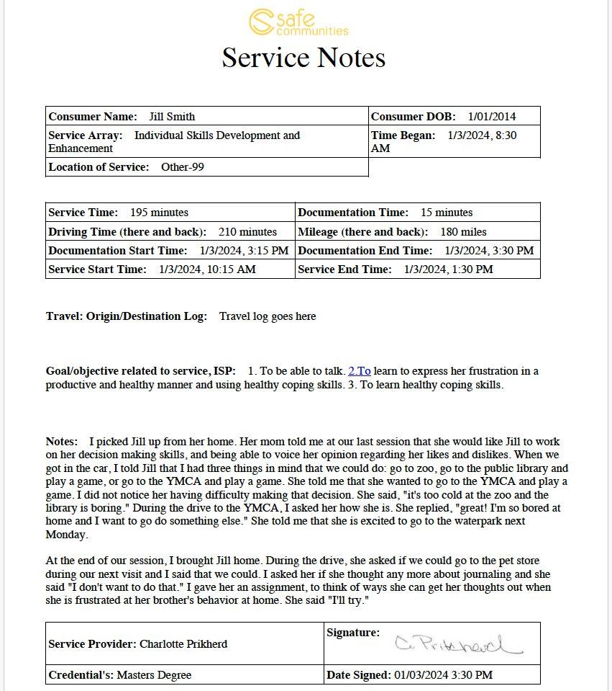
BILLING
Export data for billing or reporting purposes
Signatures
Codes
Rates
Organizational Stability
Profit/loss
Notes:
Kristina

Slide 25
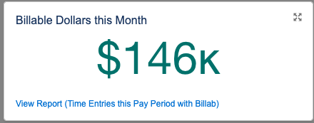
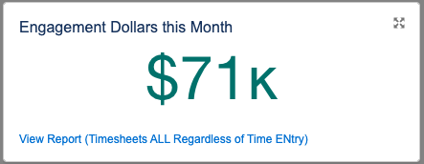
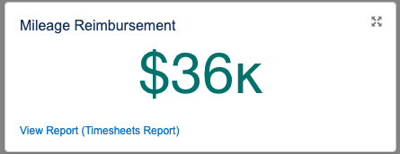
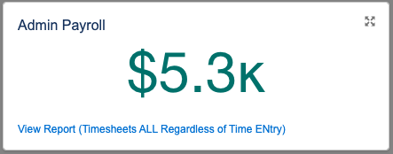
ORGANIZATIONAL STABILITY & DATA
Organizational Stability
Billing/Funding Sources must be greater than costs
Profit/loss
Notes:
Tanya

Slide 26
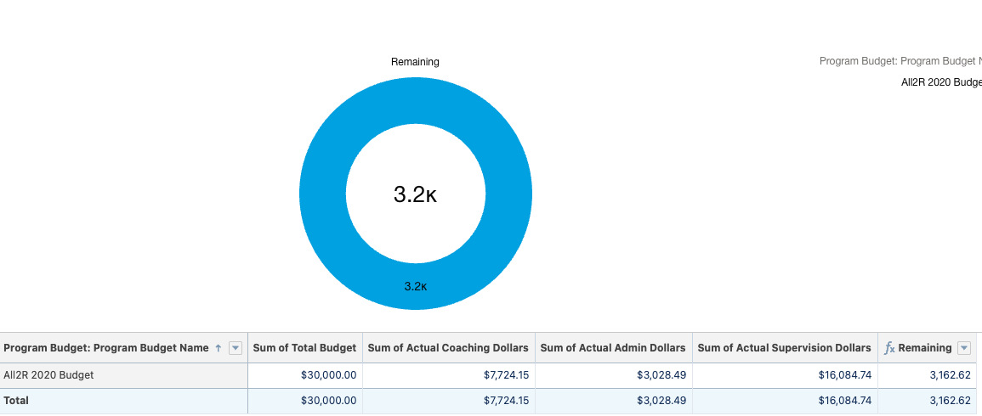
ORGANIZATIONAL STABILITY & DATA
Organizational Stability
View by Program
Spending and dollars left
Notes:
Kristina

Slide 27
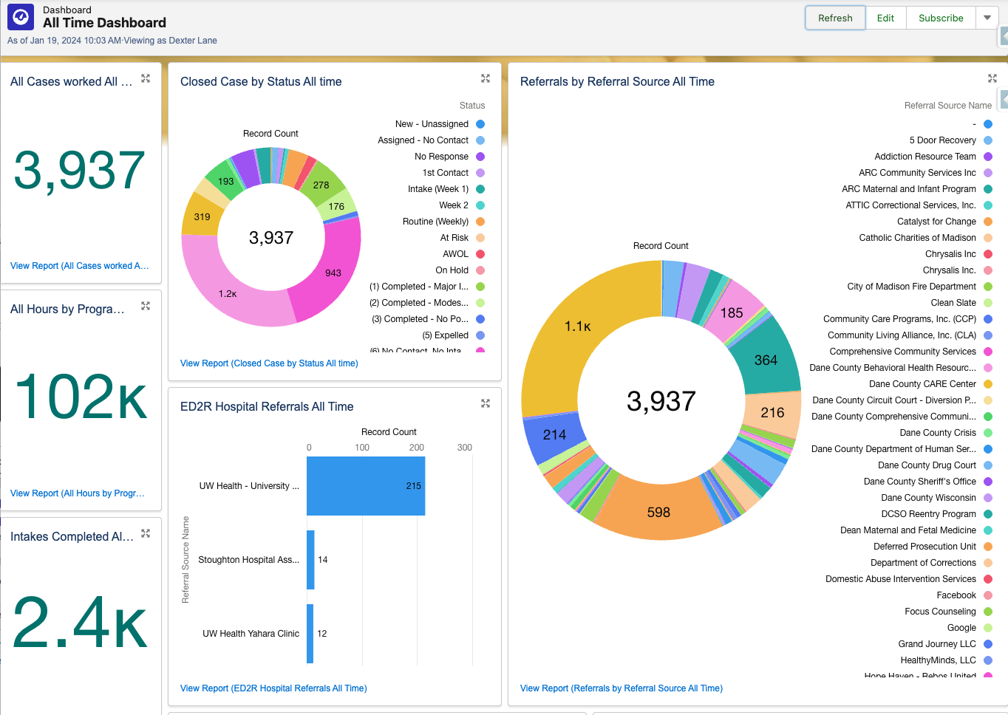
DASHBOARDS & VISUALIZATION OF DATA
Data Challenges
Data can be overwhelming
Dashboards are critical
Notes:
Tanya

Slide 28
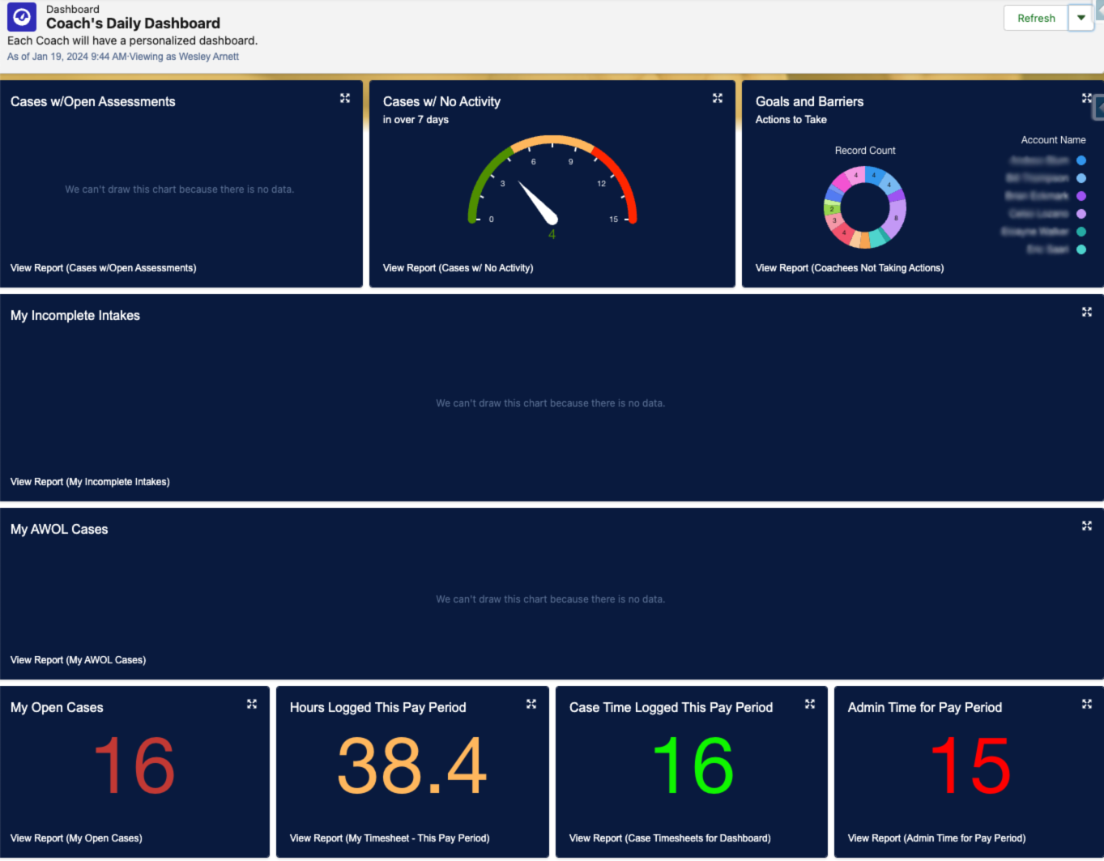
DASHBOARDS & VISUALIZATION of DATA
Data Challenges
Data must be contextual
Each user needs to see different data
Notes:
Kristina

Slide 29
DATA PITFALLS
Must be Peer Focused
3. Too much data
2. Must be easy to collect
Data for Peer Work
Do not over-collect
Provider-Friendly
Notes:
Tanya

Slide 30
DATA TO INCREASE FUNDING
3,900
25%
196
Total Engagements in
Increase in engagements
People with positive outcomes
Choose what Data to Collect
2. Regularly report data back to funders
2023
2023 vs 2022
In Opioid budget in 2023
Notes:
Kristina

Slide 31
Questions?
Notes:
Tanya

Slide 32
Thank you!
Tanya Kraege
Kristina Vaccaro
tanya@venturex.com
kristina@ventusrex.com

